Slide 1


Social Buzz
Data Analysis Project

Slide 2


Today's agenda
Project Recap
Problem
The Analytics Team
Process
Insights
Summary

Slide 3

Social Buzz
Social media & content creation
Founded by former engineers from a large social media conglomerate.
Emphasizes anonymous content with over 100 reaction types.
Over 500 million active users monthly.
Rapid growth, requiring assistance for scaling and IPO preparation.
Project Recap
Audit of Big Data Practice
Recommendations for IPO
Analysis of Top 5 content categories by popularity

Slide 4

Problem
Challenges Faced by Social Buzz
Managing massive, unstructured data from 100,000+ daily content pieces.
Lack of internal resources for effective scaling.
Need for guidance on data best practices and IPO preparation.
Specific Needs
Expertise in big data management.
Efficient scaling strategies.
Smooth IPO execution.

Slide 5



Andrew Fleming
Chief Technical Architect
The Analytics team
Marcus Rompton
Senior Principal
Piyusha Sayal
Data Analyst

Slide 6
Process
1
Data Understanding
2
Data Cleaning
3
Data Modeling
4
Data Analysis
5
Uncover Insights

Slide 7

Insights
16
Unique Category
1897
Reactions to ‘Animal’ Posts
MAY
The month with Most posts

Slide 8
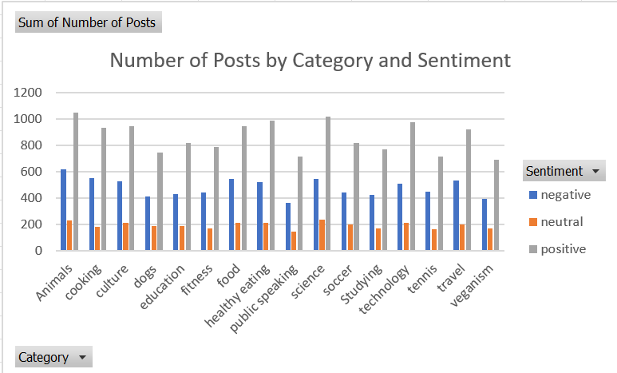
The graph displays the number of posts categorized by sentiment (negative, neutral, positive) across various content categories. Positive sentiment posts consistently dominate across all categories, with categories such as science, animals, and healthy eating showing the highest counts. Negative and neutral sentiments are relatively lower in comparison but still present a significant proportion of posts in each category.

Slide 9
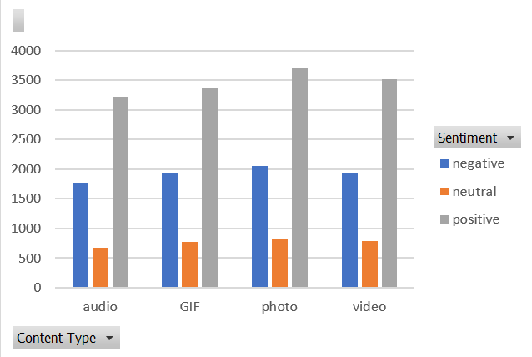
The graph illustrates the distribution of sentiment (negative, neutral, positive) across different content types (audio, GIF, photo, video). Positive sentiment posts are the most prevalent for all content types, with photos and videos having the highest number of positive posts. Negative sentiments are the second most common, followed by neutral sentiments, which have the lowest counts across all content types.

Slide 10
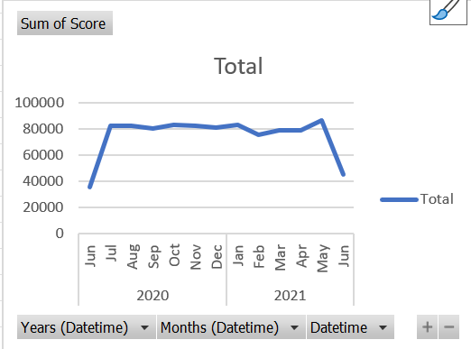
The graph displays the sum of sentiment scores over time, spanning from June 2020 to June 2021. There is a consistent trend in scores throughout the year, with a noticeable peak around May 2021 and a significant drop in June 2021. Overall, the sentiment scores remain relatively stable with minor fluctuations.

Slide 11
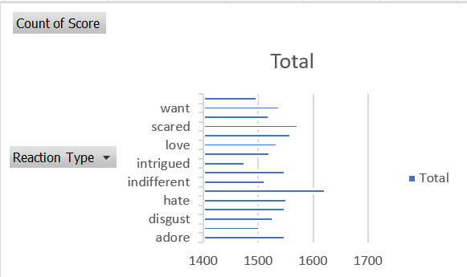
The graph presents the count of sentiment scores categorized by different reaction types. The reaction types "indifferent" and "love" show the highest counts, indicating frequent use. Other reaction types, such as "want" and "disgust," have relatively lower counts, demonstrating less frequent engagement. Overall, the data reflects varying levels of user interaction across different emotional reactions.

Slide 12

Social Buzz, a rapidly growing social media platform, has experienced exponential growth, amassing over 500 million active users per month. The company generates and processes a vast amount of unstructured data daily, requiring advanced technology and expertise to manage. To assist in their scaling process and prepare for an IPO, Social Buzz has engaged an advisory firm to provide an audit of their big data practices, recommendations for a successful IPO, and an analysis of their most popular content categories.
Summary

Slide 13
Conclusion
The data and analysis reveal several key points about Social Buzz's user engagement and content performance:
High Positive Engagement: The platform sees a substantial amount of positive engagement across various content categories and types, suggesting a generally positive user experience.
Consistent User Interaction: Sentiment scores are stable over time, indicating consistent user interaction and engagement.
Varied Emotional Reactions: Different reaction types show varied levels of engagement, with certain reactions like "indifferent" and "love" being more popular.

Slide 14
Recommendations
Focus on Positive Content: Leverage the high positive engagement by promoting and encouraging more content in categories that generate positive reactions, such as science, animals, and healthy eating.
Address Negative Sentiment: Investigate the reasons behind negative sentiments in certain categories to identify and mitigate potential issues, enhancing overall user satisfaction.
Enhance Data Management Practices: Continue to refine big data practices to efficiently manage the large volume of unstructured data, ensuring scalability and robust data analysis capabilities.
Prepare for IPO: Utilize the insights from the data analysis to inform the IPO preparation process, highlighting the platform's strong user engagement and positive sentiment trends to attract potential investors.

Slide 15
Thank you!
ANY QUESTIONS?

